Slide 1
PI Overview

Slide 2
Middleware Technology
Middleware sits "in the middle" between application Software/Application that may be working on different operating system.
It is based on XML, SOAP and Web services and Service Oriented Architecture.
It makes the maintenance of Integration between systems easier for any Large organization, being a single point to monitor all issues.
Middleware Providers – IBM, Oracle, SAP, TIBCO, Informatica, webmethods.
Image source: SAP AG.

Slide 3
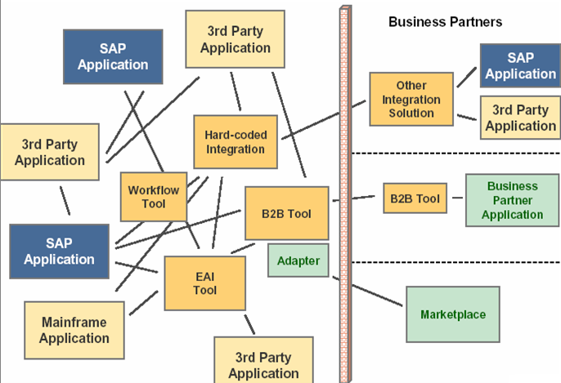
Old Integration Landscapes
Image source: SAP AG.
Many point to point integrations custom built over time using proprietary technologies
Different tools and technologies used for A2A, B2B integrations and BPM
Maintenance and administration of these landscapes
Notes:
Today, integration complexity abounds. Many components in customer system landscapes are directly connected 1:1, with all integration capabilities hardwired into the application components and individual mapping programs.
Imagine a common complex IT landscape at a customer site. This sort of ”spider web” is the epitome of today’s application integration challenge. What you see is a wildly grown integration landscape with different application systems and multiple individual connections between different interfaces. Connecting these applications does not only lead to a high complexity in managing and maintaining – there is also a lot of cost associated with it.
These systems have been integrated over time using whatever integration technology or middleware was available. The integration knowledge is hidden within the different applications or within the used middleware tools and the interface descriptions.
The overall key concept of the SAP Process integration (PI) is to drive integrated business processes across heterogeneous and highly dynamic IT landscapes in a more manageable and cost effective way.

Slide 4
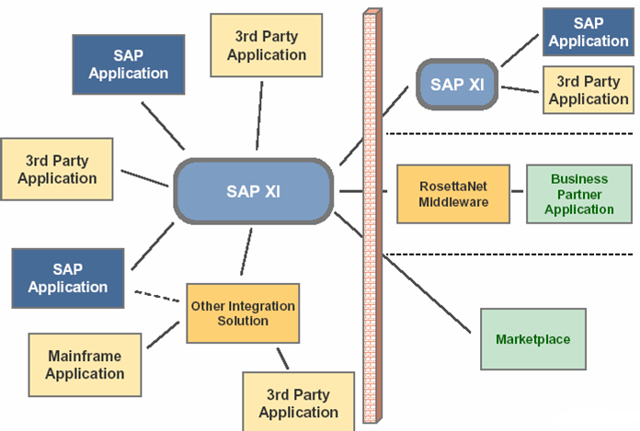
Integration using PI
Image source: SAP AG.
For integrating both SAP and non-SAP applications
For both internal (A2A) and external (B2B) process integration
Central configuration, monitoring and error handling
Notes:
SAP PI provides a technical infrastructure for XML-based message exchange to enable the integration of SAP systems with each other on the one hand, and SAP and non-SAP systems on the other.
PI also enables B2B integration using business standards like RosettaNet, CIDX, PIDX etc.
PI could co-exist with the existing EAI solutions that are existing in the client’s landscape.

Slide 5
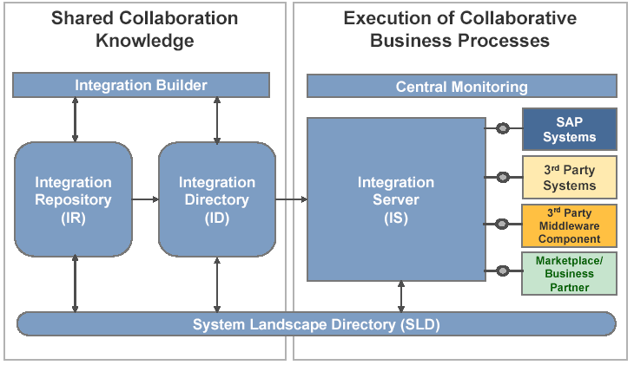
PI Component Overview
Image source: SAP AG.
Notes:
The PI is not a single component, but rather a collection of components that work together flexibly to implement integration scenarios.
The architecture includes components to be used at design time, components to be used at configuration time, and components to be used at runtime.
PI components include:
The System Landscape Directory: a central repository of information about software and systems in the data center.
The Integration Builder: A client-server framework for accessing and editing two stores of Shared Collaboration Knowledge:
The Integration Repository: For the design and development of Interface, Process, and Mapping objects that are used to implement Integration Scenarios.
The Integration Directory: For configuring scenarios from the Integration Repository in the concrete customer landscape.
The Integration Server: The central processing engine of the PI. All messages, whether SAP or non-SAP, A2A or B2B, regardless of backend technology or vendor, are processed in a consistent way.
Central Monitoring: To give a comprehensive and focused view of all components and processes at runtime.
The Adapter Engine: A Java Connector Architecture (JCA) compliant adapter engine for connecting backend systems to the PI.

Slide 6
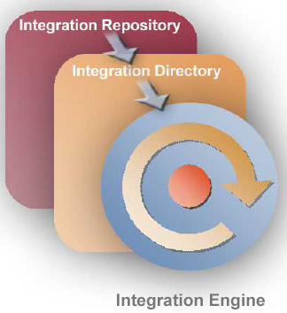
Design - Configure - Execute
Integration/Enterprise Service Repository
Used for design and development of interfaces
SAP delivers integration content for out-of-box integration of SAP applications (like SRM, CRM etc)
Integration Directory
Use for configuring the scenarios using the interfaces defined in Integration repository
Configuration based on actual customer landscape
Integration Engine
Provides the runtime for the interfaces designed and configured.
Common monitoring tools are provided as part of PI
Image source: SAP AG.
Notes:
By separating design time activities from configuration time activities, SAP can ship content for the Integration Repository, which each customer can implement for their specific landscape in the Integration Directory. As far as possible the goal is to reduce the problem of developing interfaces to the simpler task of configuring interfaces.
At runtime, the Integration Engine is based on the solid architecture of the SAP Web Application Server, leveraging the power, scalability, and manageability of the platform.

Slide 7
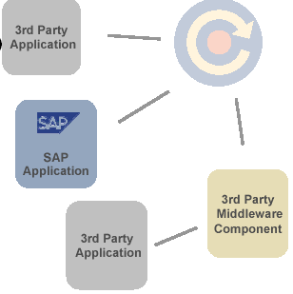
PI Interfaces
Message in PI (Interfaces) are based on XML format. These can be exported or imported to/from WSDL files.
These XML messages are transported (between PI components) based on HTTP or HTTPS protocol
SAP uses a custom message format “SOAP Messages with Attachments”
PI supports 3 types of message delivery (also know as quality of service, QOS)
Best Effort (Synchronous)
Exactly Once (Asynchronous)
Exactly Once in Order (Asynchronous)
Image source: SAP AG.
Notes:
The PI supports Synchronous and Asynchronous delivery; in PI terms, these are described with a Quality of Service (QoS) descriptor. The PI supports QoS Best Effort (BE), Exactly-once (EO), and Exactly-once-in-order (EOIO). These are equivalent to RFC types Synchronous RFC (sRFC), Transactional RFC (tRFC), and Queued RFC (qRFC), respectively. The PI is used to exchange XML messages in an implementation of the SOAP protocol. The SAP implementation of SOAP includes messages sent as attachments to the SOAP document.

Slide 8
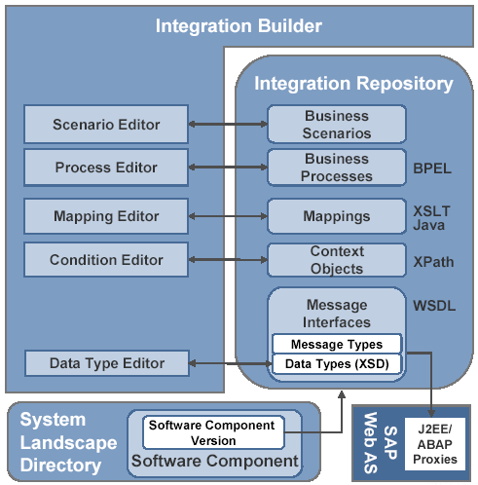
Design
Integration Repository is used for the design and development of integration scenarios.
Business content can be imported from SAP for mySAP solution integrations and B2B integrations
All the definitions use open technologies like BPEL, WSDL, XSD etc. These can be exported or imported to other tools.
Java based graphical tools deployed using Java Web Start
Image source: SAP AG.
Notes:
SAP provides the design content for mySAP solutions; other SAP interfaces, such as Remote-enabled Function Modules or IDOCs, are imported into the Integration Repository. The customer can add the collaboration knowledge of the non-SAP systems that are participating in an integration scenario.
The Integration Builder provides the editors for each object type in the Integration Repository.
All PI objects are described using web standards: Web Services Description Language (WSDL) for interfaces, XML Schema Definition Language (XSD) for messages and data types, XPath for “slicing and dicing” data in XML documents, and Business Process Execution Language (BPEL) for Integration Processes (Business Processes).

Slide 9
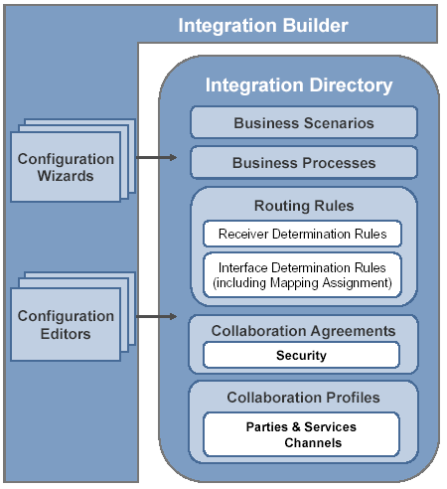
Configuration
Integration Directory is used to adapt integration content defined in Integration Repository to specific scenarios
Provides central configuration for B2B processes, BPM and Adapters
The changes activated in Directory update the runtime cache of the integration and adapter engines
Typically configuration of the scenarios would be centrally controlled by a small team for all the interfaces across the integration landscape
Java based graphical tools deployed using Java Web Start
Image source: SAP AG.
Notes:
Once Integration content has been created in the Integration Repository, scenarios are configured in the Integration Directory. In the directory we specify the actual systems that will be exchanging messages, and configure the details of the message exchange (security, transport protocol, etc.)

Slide 10
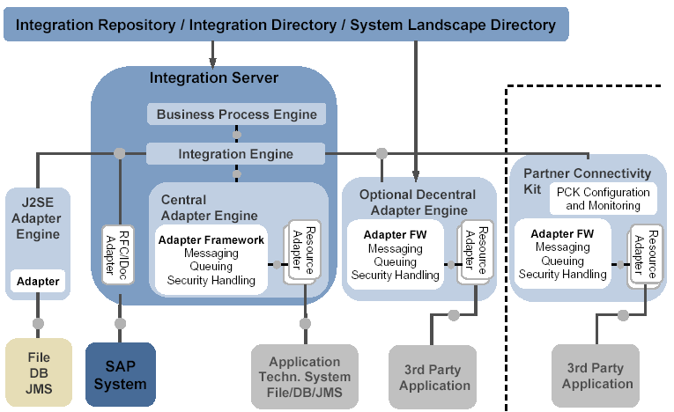
Adapter Architecture
Image source: SAP AG.
Notes:
PI Adapter Engine is based can be deployed as Central (Default), De-central or J2SE Local adapter Engine.
The PI Adapter Engine is based on Java Connector Architecture of J2EE which part of SAP Web AS.
PI provides central configuration and monitoring of all adapters deployed on Central and de-centrally (close to the backend system) engines.
The Adapter Engine includes its own security, message processing, and message queuing functionality. The inbound message to PI is converted from the native format to PI message format (XML based on SAP SOAP Format). Similarly the outbound message from PI to application systems is converted from PI format to native format supported by the application system.

Slide 11
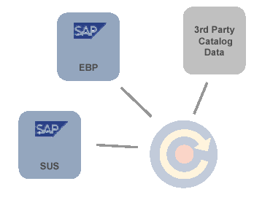
Integration Content by SAP
Integration content for integrating mySAP solutions like SRM, SCM etc
Integration content for B2B scenarios using standards like RosettaNet, CIDX, PIDX etc
This provides for out-of-box integration of SAP solutions. There would be some customization required based on the customer requirements
SAP takes care of change management of this content (as new versions of solutions are released)
Going forward more content would be available from SAP and other Business partners
Image source: SAP AG.
Notes:
Benefits
Out-of-the-box integration of SAP solutions
Simplified upgrade of SAP Solutions
Versioning and modification management of integration meta-data
SAP provides content for mySAP solutions in files that are imported into the PI.

Slide 12
Openness and Interoperability
PI is built ground-up using open standards like XML, SOAP and Java.
PI provides interoperability with other integration products using Web Services and Java Messaging Service (JMS)
PI provides flexibility for customers and partners to develop their own J2EE based Adapters (custom as per their requirement) using the Adapter Development Kit provided by SAP.
PI provides flexibility to define the transformation logic (mappings) using Graphical Mapping, Java, XSLT or ABAP
PI allows for importing Java libraries defined externally and re-using them in the mappings
Image source: SAP AG.
Notes:
Benefits
Leverage existing investments
Arrive at new integration landscape in an evolutionary manner
Allow easy and non-disruptive addition of new services and processes
PI is open and flexible; it uses web standards such as Web Services Description Language (WSDL), XML Schema Definition Language (XSD), and SOAP messaging for describing objects and communicating with other systems.

